Slide 1
Optimal Oxygen Flow Adjustment
Team 6:
Habiba Mamdouh Menna Nabil
Malak Osama Ghazzl Hossam
Malak Fathy

Slide 2
Problem Statement
Oxygen therapy is a continuous process for patients suffering from low SpO₂ .
Clinicians repeatedly adjust oxygen flow based on SpO₂ measurements.
These decisions are often manual, reactive, and may not be optimal over time.
Must be within a safe range
Inconsistency and delay

Slide 3
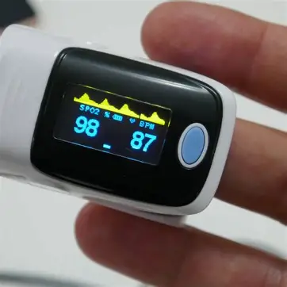
Why Oxygen Therapy Is a Difficult Control Problem
SpO₂ response depends on previous oxygen flow
Actions have delayed effects
Multiple conflicting objectives:
Reach target SpO₂
Stay within safe limits
Minimize frequent / excessive oxygen changes

Slide 4
Why Some Approaches Fail
A locally optimal decision may cause future instability
Sudden flow changes can overshoot SpO₂
Current decisions affect future costs

Slide 5
Our Idea
Instead of reacting step-by-step, we plan the entire oxygen strategy in advance
The goal is to find:
The sequence of oxygen flows that produces
stable, safe, and target-centered SpO₂
over the entire time horizon

Slide 6

Why Dynamic Programming?
Dynamic Programming is ideal because:
The system evolves step-by-step
Each decision affects future states
We want the globally optimal plan
DP allows us to:
Evaluate all possible future paths
Penalize excessive oxygen changes
Penalize unsafe SpO₂ values

Slide 7
Solution & DP Table

Slide 8
Our Solution Overview
Proposed Solution
Why This Works
Key Components
We model oxygen therapy as a sequential decision problem
At each time step, the system:
Observes current SpO₂ level
Chooses an oxygen flow rate
The goal is to find the optimal sequence of oxygen flows over time
Oxygen therapy decisions are:
Time-dependent
Influenced by previous decisions
This makes the problem suitable for Dynamic Programming (DP)
State: Current SpO₂ level
Action: Oxygen flow (0–5 L/min)
Transition: How flow affects SpO₂
Objective: Minimize total treatment cost

Slide 9
Patient Modeling
Patient Types
SpO₂ Transition Model
01
We consider different patient responses using a sensitivity parameter (α):
Adult: Moderate response to oxygen
COPD: Low response (risk of over-oxygenation)
Pediatric: High response
02
Next SpO₂ depends on:
Current SpO₂
Selected oxygen flow
Patient type
Constraints
03
SpO₂ is bounded between:
Minimum: 70%
Maximum: 100%

Slide 10
Cost Function
Cost Components
Goal
Minimize the total cost over the time horizon T
Role of λ (Lambda)
Target Deviation
Penalizes distance from target SpO₂
Smoothness Penalty
Penalizes frequent oxygen flow changes
Safety Constraint
Penalizes SpO₂ outside the safe range
Controls trade-off between:
Accuracy (reach target)
Stability (smooth oxygen changes)

Slide 11
Dynamic Programming Formulation
Recurrence Relation
Initialization
Definition
DP[t][s] = Minimum cost to reach SpO₂ = s at time t
For each time step:
Try all possible oxygen flows
Compute next SpO₂
Update minimum cost
Start from initial SpO₂ at time t = 0

Slide 12
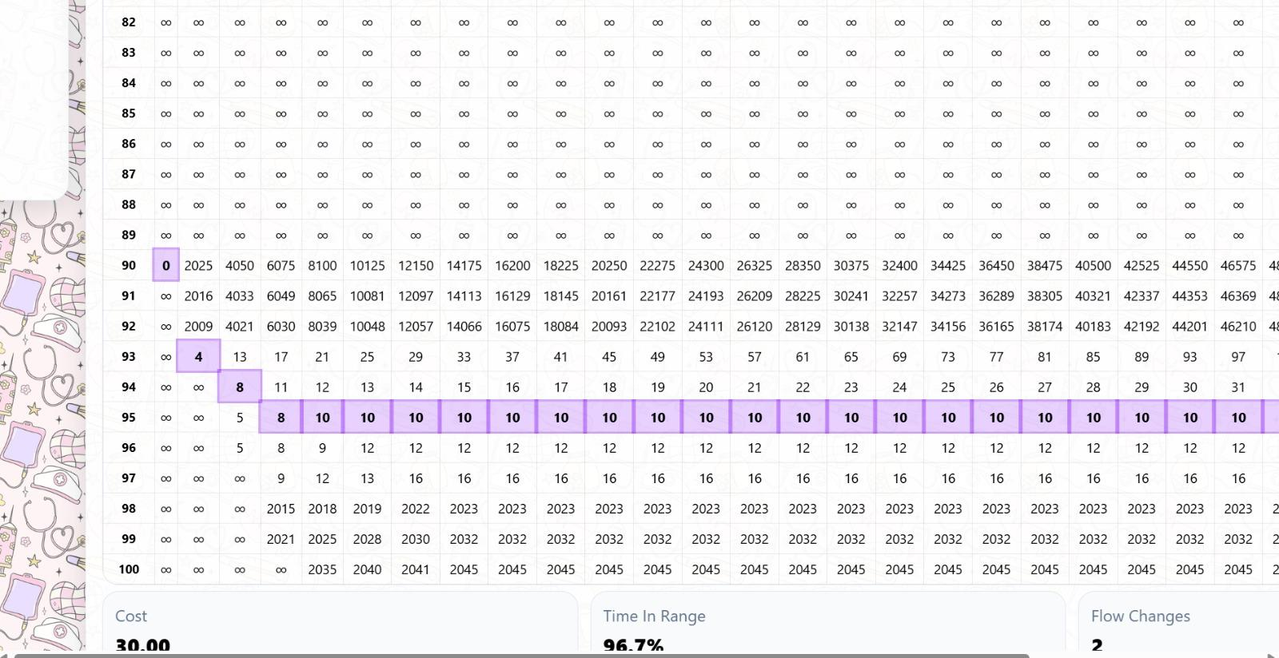
DP Table Interpretation
Rows: Possible SpO₂ values
Columns: Time steps
Cells: Cumulative cost
Best Path
Minimum cost at final time is selected
Backtracking retrieves:
Optimal oxygen flow sequence
Optimal SpO₂ trajectory

Slide 13
Thank You

